Slide 1
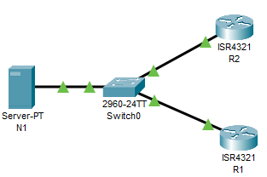
Packet Tracer - Configure and Verify NTP NETWORK TIME PROTOCOL
time synchronization

Slide 2
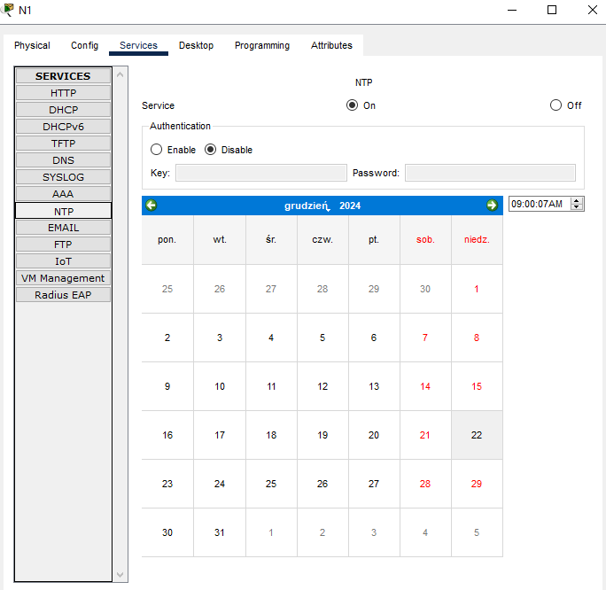
Packet Tracer - Configure and Verify NTP

Slide 3
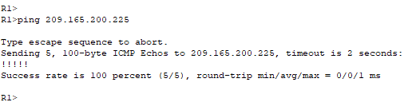
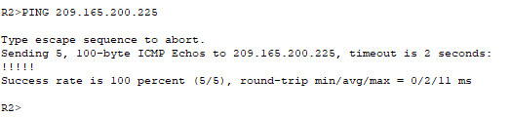
Packet Tracer - Configure and Verify NTP

Slide 4
Packet Tracer - Configure and Verify NTP
R1
R1# show ntp status
%NTP is not enabled.
R1# show clock detail
R1# conf t
R1(config)# ntp server 209.165.200.225
R1# show ntp status
Clock is synchronized, stratum 2, reference is 209.165.200.225
R1# show ntp associations
R1#show clock detail

Slide 5
Packet Tracer - Configure and Verify NTP
R2
R2# show ntp status
%NTP is not enabled.
R2# show clock detail
R2# conf t
R2(config)# ntp server 209.165.200.225
R2# show ntp status
Clock is synchronized, stratum 2, reference is 209.165.200.225
R2# show ntp associations
R2#show clock detail

